Slide 1


Computer Vision BS-CS (Elective)
Instructor: Dr. Mohammad Asif Khan
asif.khan@iba-suk.edu.pk
Week 4

Slide 2
Unit 01 Week 04 Traditional Computer Vision

Slide 3
Contents
Image features
Image features invariance
Types of features
SIFT (Scale In-variant Feature Transform)
FAST (Features from Accelerated Segment Test)
SURF (Speeded-Up Robust Features)
Harris
BRIEF (Binary Robust Independent Elementary Features)
ORB (Oriented FAST and Rotated BRIEF)

Slide 4
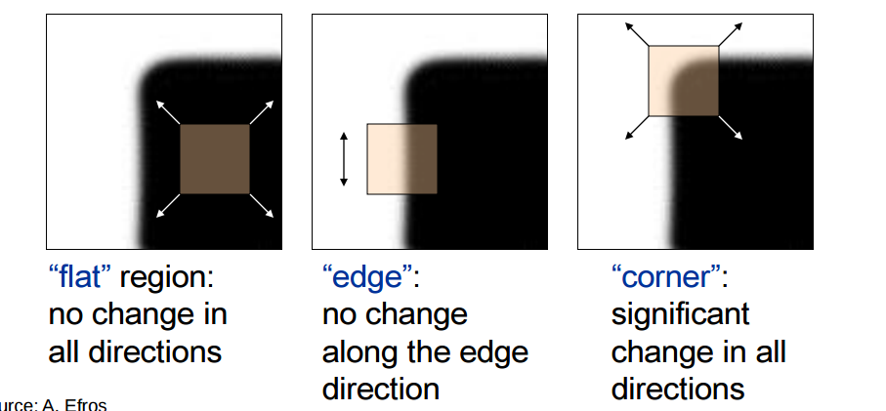
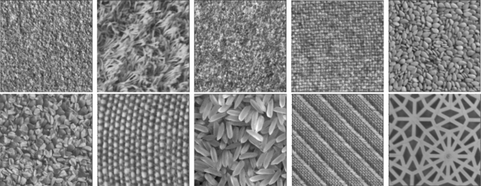
Image Features
Image features are distinctive pieces of information extracted from images.
They represent meaningful patterns such as edges, corners, textures, or regions.
Act as “landmarks” or “building blocks” for understanding images.
Example: Edges of objects, corner points, or specific textures.
Role in Computer Vision:
Features enable computers to interpret and analyze images.
Simplify raw pixel data into useful representations.
Provide robustness against noise, lighting changes, and viewpoint shifts.
Figure sources:https://sites.cc.gatech.edu/computing/classes/AY2016/cs4476_fall/results/proj2/html/pbhutada6/index.html?ref=blog.roboflow.com
https://link.springer.com/article/10.1007/s11042-022-14276-y

Slide 5
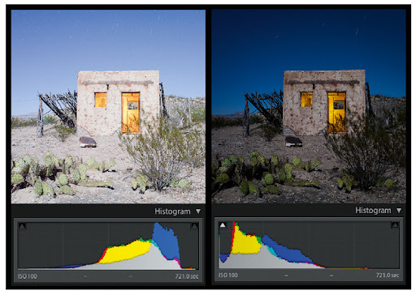
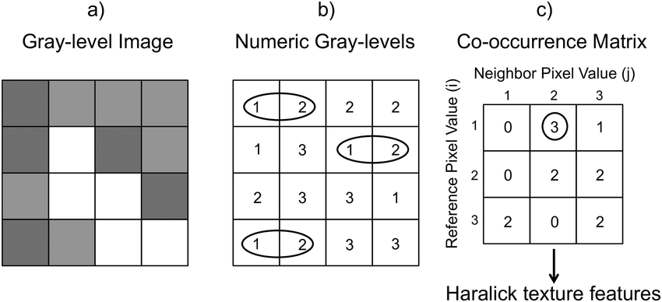
Types of Image Features
Image features are classified as local and global features.
Global Features describe the image as a whole.
It capture overall properties or statistics.
Global features are useful for tasks like scene classification or image retrieval.
Examples:
Color Histograms: Distribution of colors in an image.
Texture Descriptors: Patterns of intensity variation (e.g., GLCM, Haralick features).
Edge Histograms: Overall edge distribution.
Figure sources: http://facweb.cs.depaul.edu/sgrais/night_photography.htm
Notes:
GLCM (Gray level co-occurrence matrix) and Haralick features as methods to describe and analyze texture in images.
Haralick texture descriptor saves the transition from one intensity value to another

Slide 6
Types of Image Features
A Gray Level Co-occurrence Matrix (GLCM) is a statistical method used to describe the texture of a grayscale image.
It tells us: How often different combinations of gray levels occur next to each other in an image.
Texture is about patterns of intensity changes.
GLCM measures:
Which gray level is next to which gray level
How frequently this happens
In a specific direction (0◦, 45◦, 90◦, 135◦) and distance.
Figure sources: http://facweb.cs.depaul.edu/sgrais/night_photography.htm
Notes:
GLCM (Gray level co-occurrence matrix) and Haralick features as methods to describe and analyze texture in images.
Haralick texture descriptor saves the transition from one intensity value to another

Slide 7
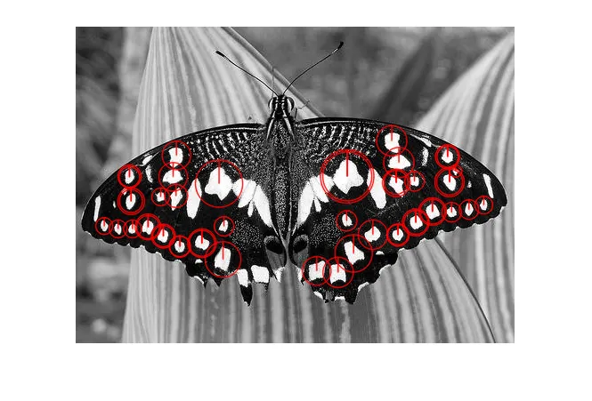
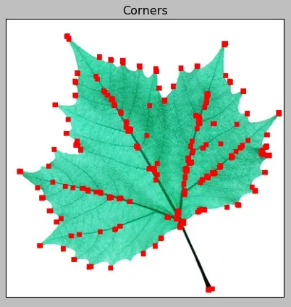
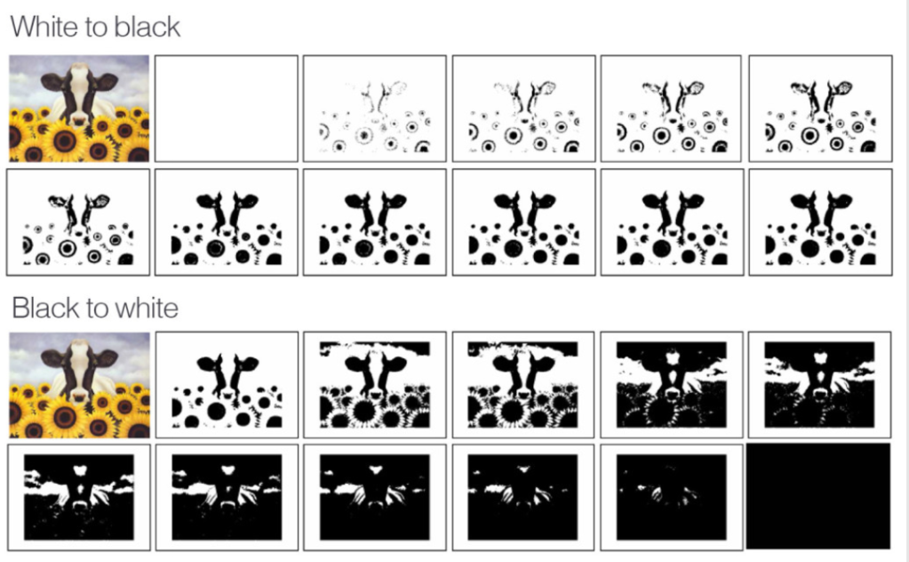
Types of Image Features
Local Features are detected at specific keypoints or regions in the image.
It capture distinctive patterns at local areas.
Useful for tasks like object recognition, matching, and tracking.
Examples:
Corners: Points where edges meet (e.g., Harris, Shi-Tomasi).
Blobs: Regions with consistent intensity.
Edges: Local gradients or boundaries. Edges in computer vision are significant, abrupt changes in image brightness, color, or texture that typically signify object boundaries, surface, or structural features
Regions: Regions in computer vision are connected sets of pixels within an image that share similar characteristics (color, intensity, or texture), representing objects or meaningful parts of a scene. They are critical for image segmentation, object detection.
Figure sources: https://medium.com/aimonks/computer-vision-103-feature-extraction-and-description-97b02998da03
Notes:
GLCM (Gray level co-occurrence matrix) and Haralick features as methods to describe and analyze texture in images.

Slide 8
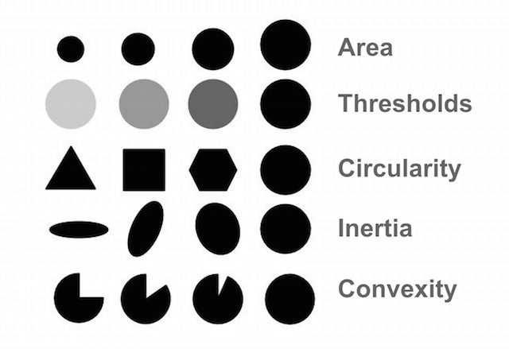
Types of Image Features
A blob is a region in an image where some properties—such as intensity or color—are uniform or vary within a defined range. Blobs are usually visually distinguishable structures like:
Bright or dark spots
Regions of uniform color or texture
Objects with approximately circular or elliptical shapes
In simpler terms, blobs are groupings of connected pixels that we consider as one unit of information.
Figure sources: https://opencv.org/blog/blob-detection-using-opencv/
Notes:
GLCM (Gray level co-occurrence matrix) and Haralick features as methods to describe and analyze texture in images.

Slide 9
Local Features Vs Global Features
Aspect | Local Features | Global Features
Definition | Features at specific keypoints/regions | Features describing the whole image
Examples | Corners, blobs, edges (e.g., SIFT, Harris) | Color histograms, texture descriptors
Spatial Info | Preserve location (x, y) | Usually lose spatial arrangement
Robustness | Robust to occlusion, scale, rotation | Sensitive to viewpoint, illumination
Use Cases | Object recognition, matching, tracking | Scene classification, image retrieval
Computation | More expensive due to detection/description | Generally faster, simpler calculations
Dimensionality | High-dimensional per keypoint | Lower-dimensional global summaries

Slide 10
Categories of Image Features
Edge Features
Canny, Sobel, Prewitt
Corner Features
Harris corner detection
Shi-Tomasi (Good Features to Track)
Blob Features
Laplacian of Gaussian (LoG)
Difference of Gaussians (DoG)
Region-Based Features
MSER (Maximally Stable Extremal Regions)
Texture Features
Local Binary Patterns (LBP)
Gabor filters
Color Features
RGB/HSV/Histogram representations

Slide 11
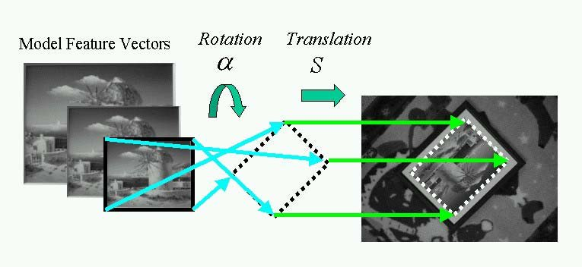
Characteristics of Good Features
Invariance (scale, translation, rotation, viewpoint and illumination)
Feature invariance means a feature remains stable and recognizable despite changes in image conditions.
This ensures robustness in detection and matching tasks.
Without invariance, features detected in one image may fail to appear in another under different conditions.
Repeatability
Repeatability measures how consistently a feature detector can find the same features in an image under different conditions, such as:
Changes in viewpoint (angle, perspective)
Lighting variations
Scale changes
Noise or blur
Distinctiveness
Efficiency (low computation cost)
Figure sources: https://www.researchgate.net/figure/Corresponding-pairs-are-computed-by-matching-rotation-invariant-feature-vectors-Rotation_fig5_37991935

Slide 12
Characteristics of Good Features
Invariance (scale, translation, scale, rotation and illumination)
Repeatability
Distinctiveness
Distinctiveness refers to how unique and identifiable a feature is within an image or across images.
Helps to avoid confusion between similar-looking points.
A corner at a building edge is more distinctive than a flat, uniform surface patch.
Features that look similar in different places (like repetitive windows) have low distinctiveness and can cause matching errors.
Efficiency (low computation cost)
Efficiency refers to how fast and resource-friendly a feature detector and descriptor are when processing images.
Low computational cost means the algorithm can run quickly and use minimal memory or processing power.
Important for real-time applications (e.g., video tracking, robotics, mobile devices).
Examples:
FAST corner detector is very efficient, suitable for real-time detection.
ORB is designed as a fast alternative to SIFT/SURF with good performance.
Figure sources: https://www.researchgate.net/figure/Corresponding-pairs-are-computed-by-matching-rotation-invariant-feature-vectors-Rotation_fig5_37991935

Slide 13
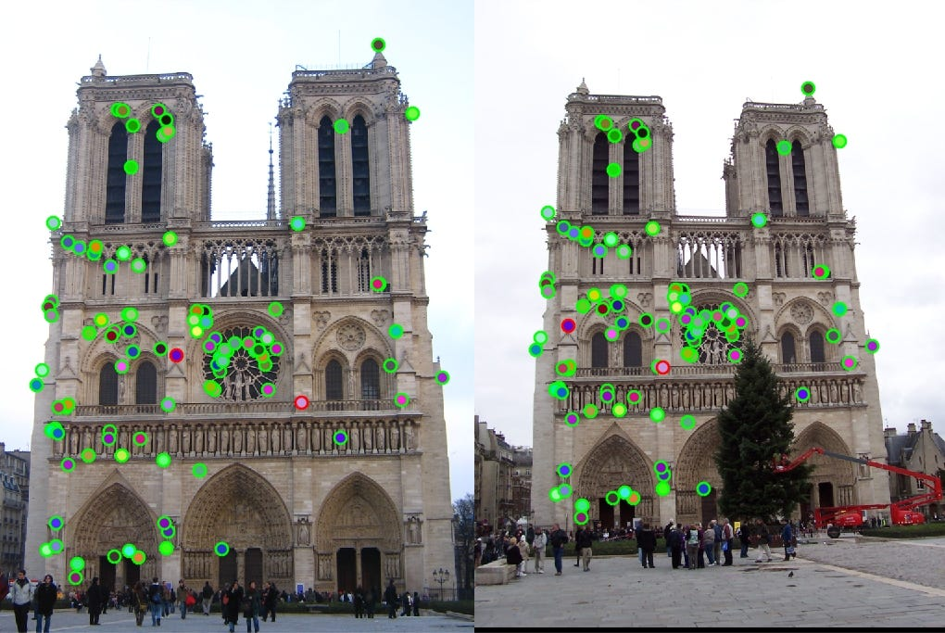
Feature Extraction
The process of transforming raw image data (pixels) into a set of measurable and meaningful features.
Extracted features summarize important information about the image content.
Reduce complexity of raw data for easier analysis.
Capture important patterns like edges, corners, textures, or shapes.
Serve as input for higher-level tasks (classification, recognition, matching).
Dimensionality Reduction:
Image is high-dimensional function.
Images have thousands to millions of pixels → too large for direct processing.
Features reduce data size while preserving essential information.
Improves speed, efficiency, and accuracy of computer vision algorithms.
Figure sources: https://www.researchgate.net/figure/Corresponding-pairs-are-computed-by-matching-rotation-invariant-feature-vectors-Rotation_fig5_37991935

Slide 14
Classical Feature Extraction
Harris Corner Detector
Based on intensity gradients
SIFT (Scale-Invariant Feature Transform)
Keypoint detection and descriptor
Scale and rotation invariant
SURF (Speeded-Up Robust Features)
Faster than SIFT, similar goals
FAST (Features from Accelerated Segment Test)
High-speed corner detection
ORB (Oriented FAST and Rotated BRIEF)
Efficient, free alternative to SIFT/SURF
Good for real-time applications
Figure sources: https://www.researchgate.net/figure/Corresponding-pairs-are-computed-by-matching-rotation-invariant-feature-vectors-Rotation_fig5_37991935

Slide 15
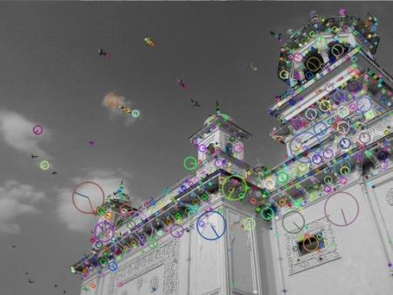
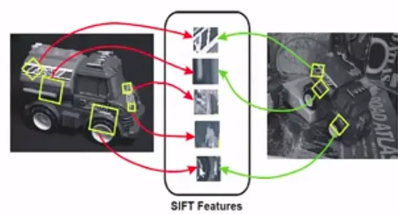
SIFT (Scale-Invariant Feature Transform)
SIFT is a robust local feature detection and description algorithm.
Invented by David Lowe (1999), published in 2004.
Key idea: detect distinctive, repeatable points that are invariant to:
Scale
Rotation
Illumination changes
Some affine transformations
Used in object recognition, matching, tracking, and more.
Figure sources: https://www.researchgate.net/figure/Corresponding-pairs-are-computed-by-matching-rotation-invariant-feature-vectors-Rotation_fig5_37991935

Slide 16
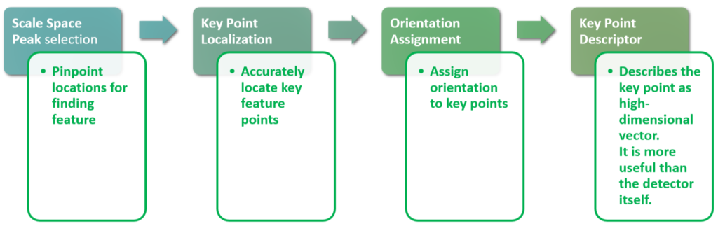
SIFT (Scale-Invariant Feature Transform)
Step for SIFT features extraction and description
Scale-space extrema detection: Find potential interest points
Keypoint localization: Refine positions and discard unstable points
Orientation assignment: Assign consistent direction
Descriptor generation: Build a distinctive feature vector
Figure sources: https://www.geeksforgeeks.org/machine-learning/sift-interest-point-detector-using-python-opencv/

Slide 17
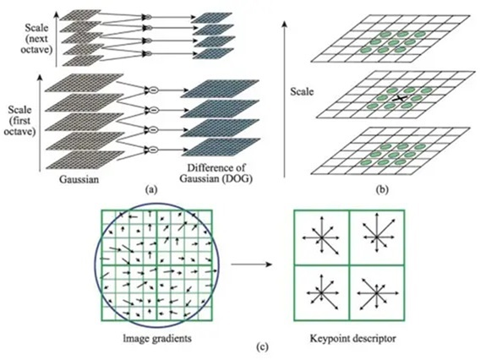
SIFT (Scale-Invariant Feature Transform)
SIFT feature extraction and description process:
Scale-space extrema detection
Keypoint localization
Orientation assignment
(c) Descriptor generation
Figure sources: https://www.geeksforgeeks.org/machine-learning/sift-interest-point-detector-using-python-opencv/

Slide 18
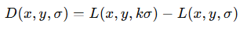
SIFT: Scale space extrema detection
Identifying potential keypoints
Goal: Detect features invariant to scale
Use Gaussian scale space:
G: Gaussian kernel
𝐼: input image
∗: convolution
To efficiently cover a wide range of scales, SIFT builds octaves of images:
Each octave is a set of images progressively blurred with increasing 𝜎.
At the end of each octave, the image is downsampled by a factor of 2 (reduce width and height by half) to create the first image of the next octave.
This downsampling allows the algorithm to detect features at progressively larger scales without increasing the Gaussian kernel size infinitely.
Calculate Difference of Gaussians (DoG) between adjacent blurred images in each octave:

Slide 19
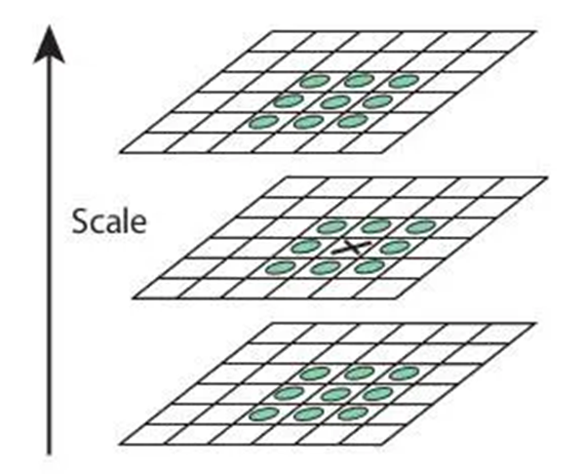
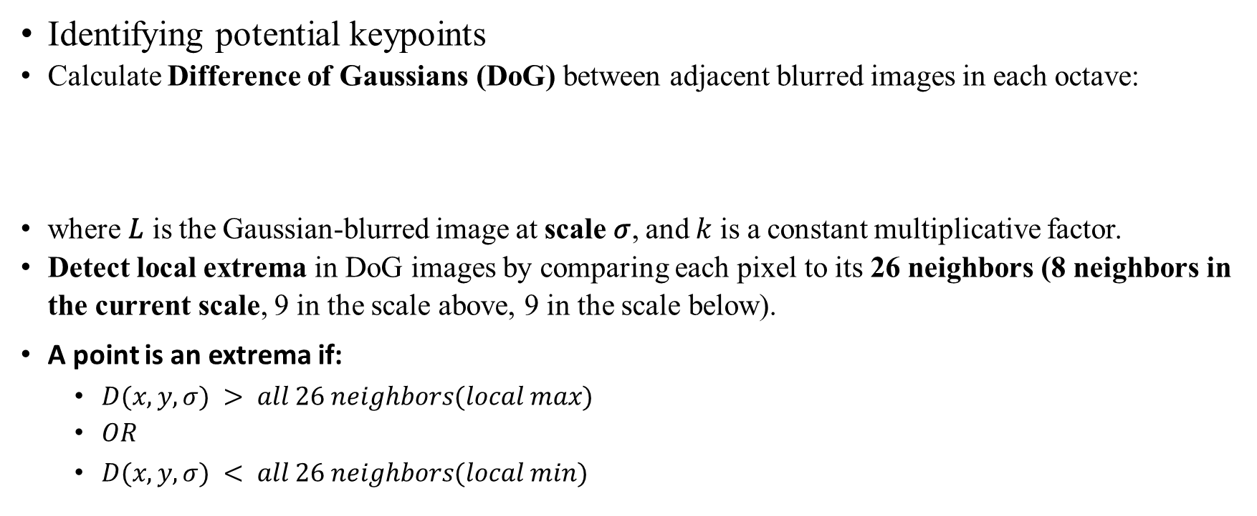
SIFT: Scale space extrema detection
Identifying potential keypoints
Calculate Difference of Gaussians (DoG) between adjacent blurred images in each octave:
where 𝐿 is the Gaussian-blurred image at scale 𝜎, and 𝑘 is a constant multiplicative factor.
Detect local extrema in DoG images by comparing each pixel to its 26 neighbors (8 neighbors in the current scale, 9 in the scale above, 9 in the scale below).
A point is an extrema if:
$D(x,y,σ) > all 26 neighbors(local max)$
$OR$
$D(x,y,σ) < all 26 neighbors(local min)$

Slide 20
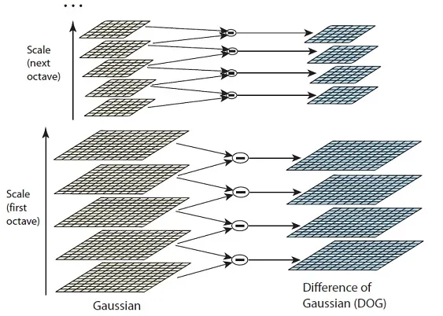
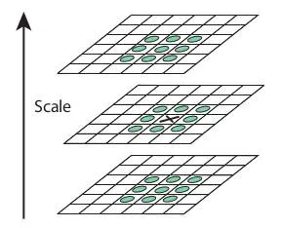
SIFT: Scale space extrema detection
Finding local extrema

Slide 21
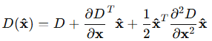
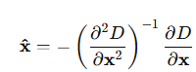
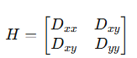
SIFT: Precise Keypoint Localization and Filtering
Precise Keypoint Localization and Filtering:
Refine the initial candidate keypoints detected in the DoG scale space for accuracy and stability.
Initial extrema are at discrete pixel locations — refine to sub-pixel accuracy using a Taylor series expansion of the DoG function 𝐷(𝑥) around the candidate keypoint.
Approximate 𝐷(𝑥) by its second-order Taylor expansion at offset
The refined location is the original keypoint plus 𝑥^.
Discard low contrast keypoints:
Compute the value of the DoG function at the refined location 𝐷(𝑥^).
If ∣𝐷(𝑥^)∣ < contrast threshold (e.g., 0.03), discard keypoint — likely caused by noise.
Eliminate Edge Responses Using Hessian Matrix

Slide 22
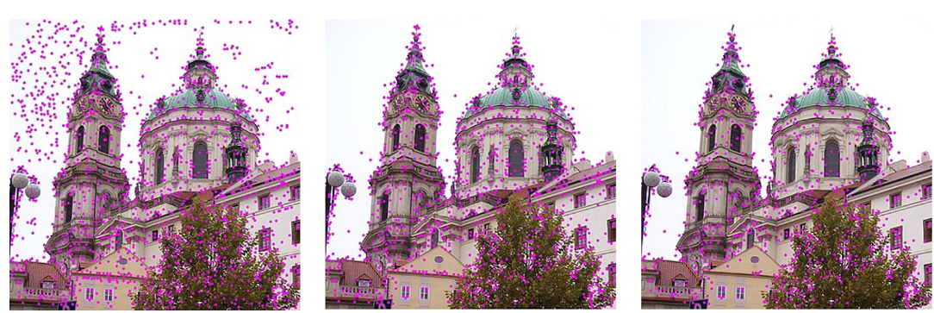
SIFT: Precise Keypoint Localization and Filtering
Precise Keypoint Localization and Filtering:
Initial keypoints
Keypoints after threshold
Keypoints after removing edge responses

Slide 23
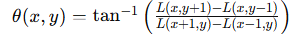
SIFT: Assigning orientations
Assigning Orientation to:
For rotation invariance, assign one or more orientations to each keypoint.
In a circular neighborhood (radius 1.5σ) for each pixel in this region, compute:
Gradient magnitude:
Gradient orientation:
Build 36-bin histogram of orientations weighted by:
Gradient magnitude
Gaussian window centered at keypoint
Dominant orientation(s) assigned to keypoint

Slide 24
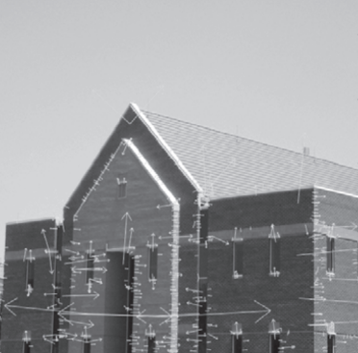
SIFT: Assigning orientations
Assigning Orientation

Slide 25
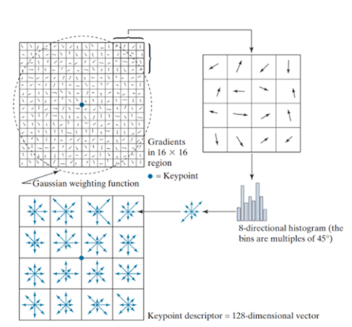
SIFT: Descriptor
SIFT Descriptor:
Steps:
Rotate coordinate system to keypoint’s orientation
Sample a 16×16 window around keypoint
Divide into 4×4 grid of subregions (each 4×4 pixels)
For each subregion:
Create 8-bin histogram of gradient orientations
Result: 4×4×8 = 128-dimensional descriptor
Normalize vector: Unit length
Threshold values > 0.2
Normalize again (improves illumination invariance)

Slide 26
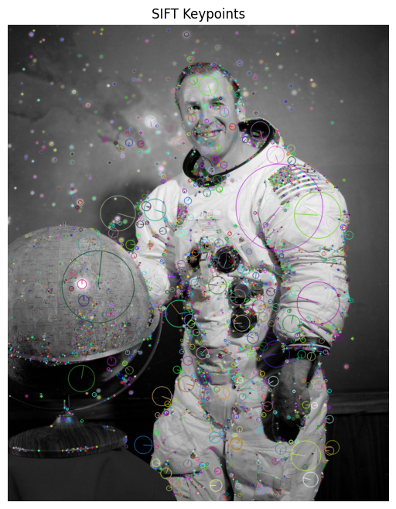
SIFT with famous Astronaut
The arrows are showing different orientations.
The different sized circles are showing keypoints at different scales.

Slide 27
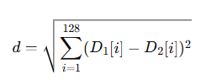
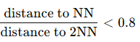
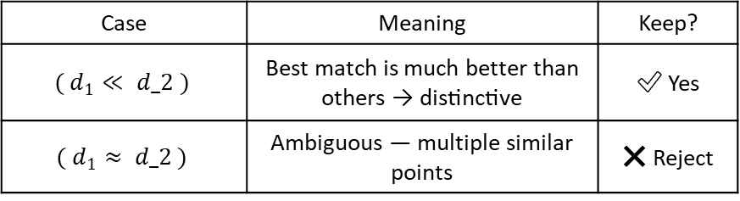
SIFT descriptor matching
SIFT descriptor matching involves finding pairs of keypoints with similar descriptors.
Descriptor Distance Metric:
Descriptor vectors are compared using Euclidean distance (L2 norm).
Smaller distance → higher similarity between descriptors.
Keypoints are matched by pairing descriptors with the lowest Euclidean distance.
Nearest Neighbor and Ratio Test:
For each descriptor in Image 1, find its:
Nearest neighbor (NN): closest descriptor in Image 2.
Second nearest neighbor (2NN): second closest descriptor in Image 2.
Apply Ratio Test (David Lowe, 2004):
Case | Meaning | Keep?
$$( d_{1}≪ d_2 )$$ | Best match is much better than others → distinctive | ✅ Yes
$$( d_{1}≈ d_2 )$$ | Ambiguous — multiple similar points | ❌ Reject

Slide 28
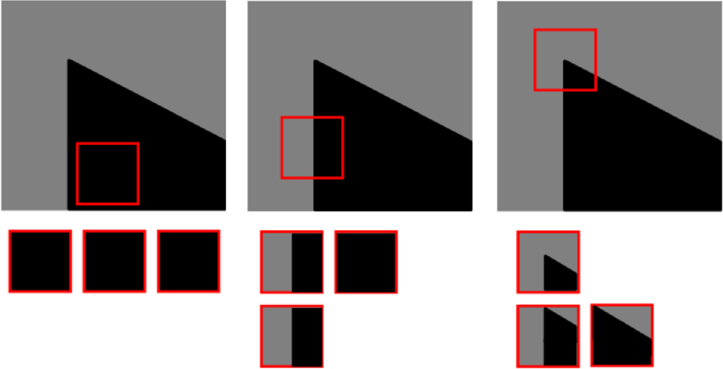
Distinctiveness and Uniqueness of features
Corners: A corner is a point where gradients change in multiple directions.
Definition of a corner in image terms: points where two edges meet
This two-dimensional change makes it highly distinctive.
It's much easier for an algorithm to find a unique match for a specific corner in another image because its pattern is complex and rare.
Edges: An edge is a one-dimensional structure.
While it has a strong gradient in one direction, it looks very similar along the length of the edge.
If you try to match a point on an edge, you can easily "slide" along the edge without changing the appearance much, leading to ambiguity. This is known as the aperture problem.

Slide 29
Distinctiveness and Uniqueness of features
Blobs: A Blob is a group of connected pixels in an image that share some common property (e.g., grayscale value).
A blob (a region) is distinctive and can be good for matching.
However, its larger area can sometimes make it less precise to locate and more susceptible to change if the lighting or texture inside the blob changes uniformly.

Slide 30
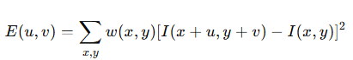
Harris Corner Detector
Developed by Chris Harris and Mike Stephens (1988)
Detects corners by analyzing local changes in intensity
Widely used for motion tracking, 3D reconstruction, object recognition
Intensity function 𝐼(𝑥,𝑦) of an image
Small shifts (𝑢,𝑣) in window around a point
Change in intensity:
E(u, v): the energy or change in intensity due to the shift (𝑢,𝑣)
𝐼(𝑥, 𝑦): the intensity at position (𝑥,𝑦)
𝐼(𝑥+𝑢, 𝑦+𝑣): the intensity at a shifted location
𝑤(𝑥, 𝑦): a window function, often a Gaussian, that gives more weight to pixels near the center
∑𝑥, 𝑦​: summation over a small window around the point being analyzed

Slide 31
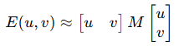
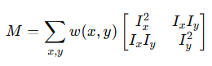
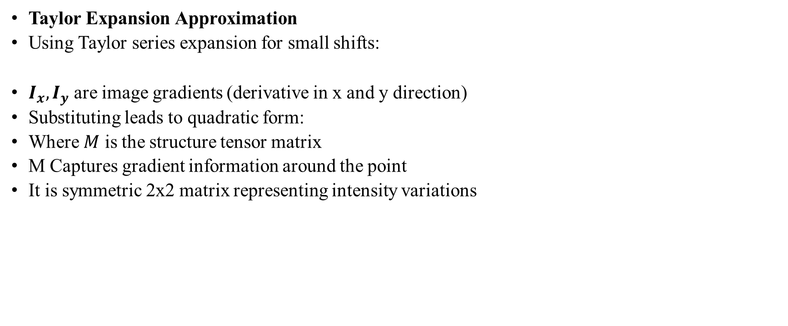
Harris Corner Detector
Taylor Expansion Approximation
Using Taylor series expansion for small shifts:
$I_{x}​, I_{y}$are image gradients (derivative in x and y direction)
Substituting leads to quadratic form:
Where 𝑀 is the structure tensor matrix
M Captures gradient information around the point
It is symmetric 2x2 matrix representing intensity variations

Slide 32
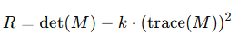
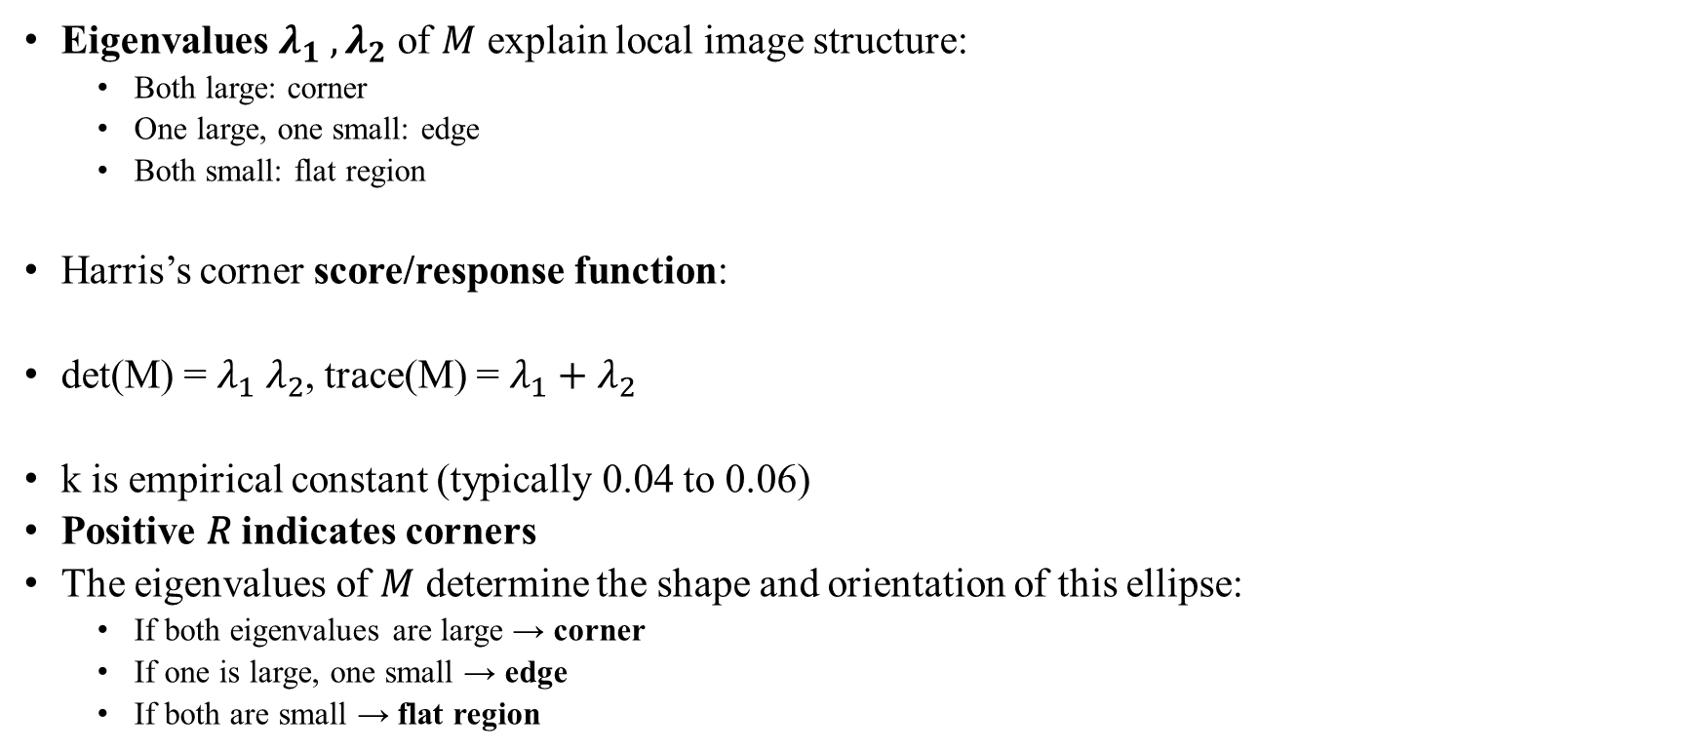
Harris Corner Detector
Eigenvalues $λ_{1} ​, λ_{2}$​ of 𝑀 explain local image structure:
Both large: corner
One large, one small: edge
Both small: flat region
Harris’s corner score/response function:
det(M) = $λ_{1} ​λ_{2}$​, trace(M) = $λ_{1}​+λ_{2}$​
k is empirical constant (typically 0.04 to 0.06)
Positive 𝑅 indicates corners
The eigenvalues of 𝑀 determine the shape and orientation of this ellipse:
If both eigenvalues are large → corner
If one is large, one small → edge
If both are small → flat region

Slide 33
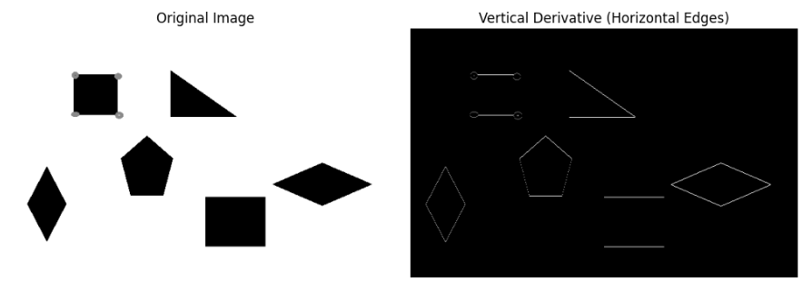
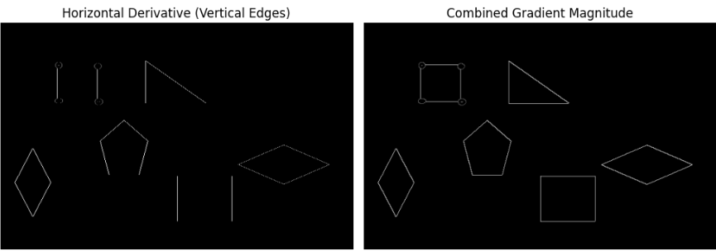
Harris Corner Detector

Slide 34
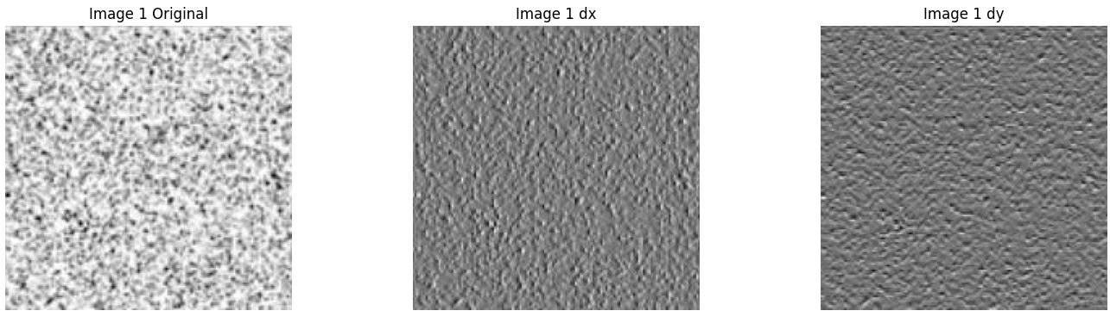
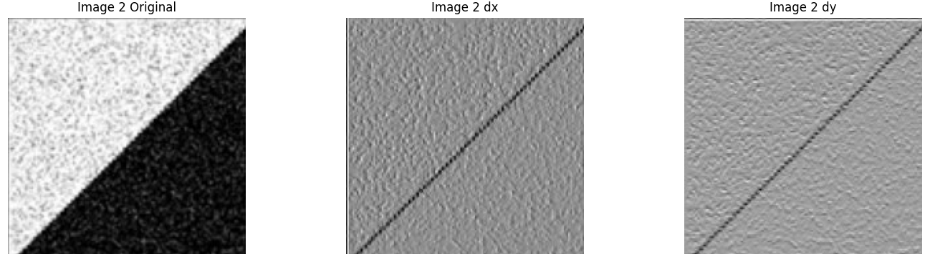
Harris Corner Detector

Slide 35
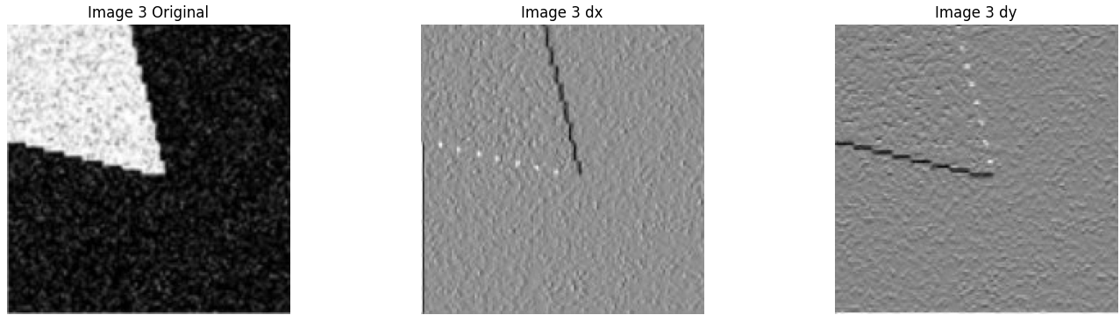
Harris Corner Detector

Slide 36
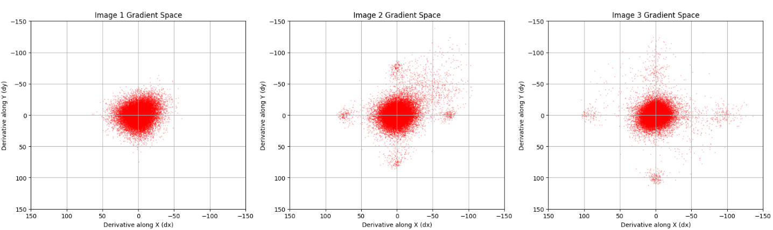
Harris Corner Detector

Slide 37
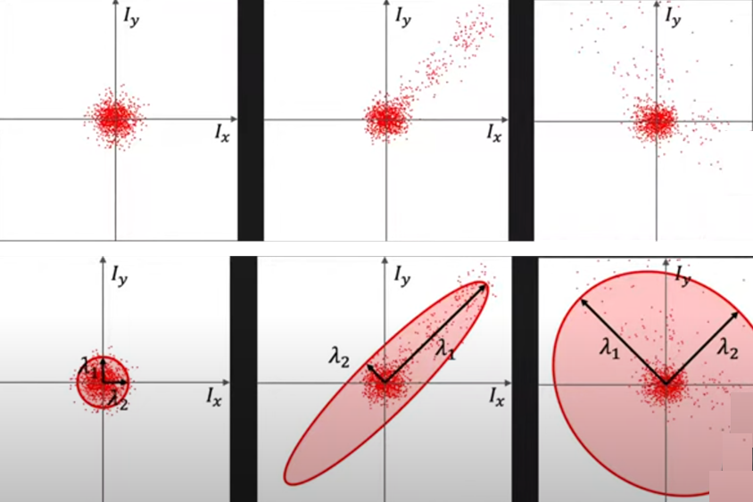
Harris Corner Detector

Slide 38
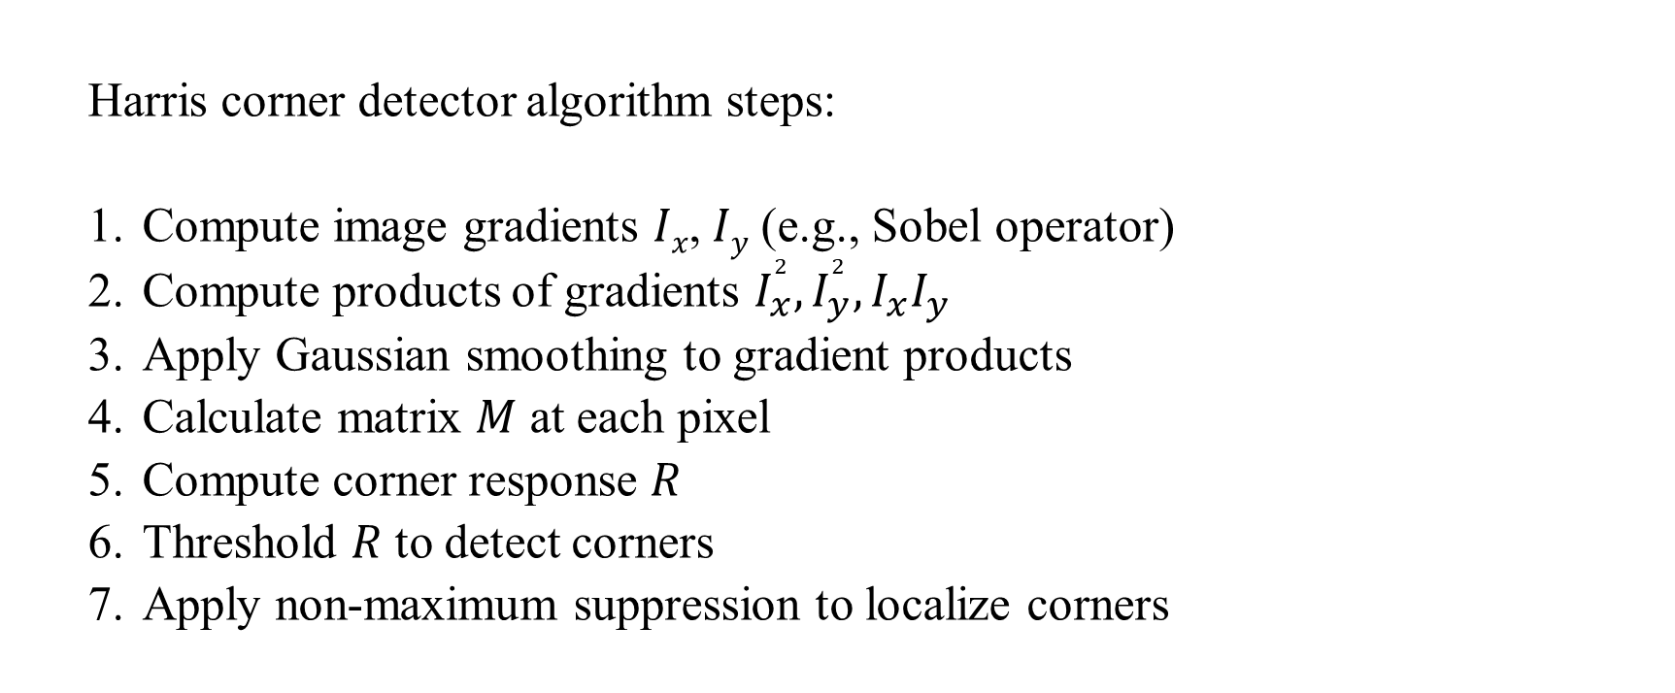
Harris Corner Detector
Harris corner detector algorithm steps:
Compute image gradients 𝐼_{𝑥}​, 𝐼_{𝑦}​ (e.g., Sobel operator)
Compute products of gradients $I_{x}^{2}​,I_{y}^{2}​, I_{x}​I_{y}$
​Apply Gaussian smoothing to gradient products
Calculate matrix 𝑀 at each pixel
Compute corner response 𝑅
Threshold 𝑅 to detect corners
Apply non-maximum suppression to localize corners

Slide 39
FAST Features Extractor
Why do we need FAST?
Traditional detectors (e.g., Harris) are accurate but slow.
Real-time applications (e.g., SLAM, AR) need speed.
FAST is designed for speed without sacrificing much accuracy.
FAST is a corner detector — not a descriptor.
Works by testing if a pixel is a corner using its intensity compared to a ring of pixels.
Fast because it uses early termination and simple comparisons.
"A pixel is a corner if a set of contiguous pixels around it are all significantly brighter or darker than the center pixel."

Slide 40
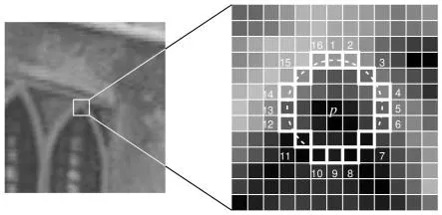
FAST Features Extractor
FAST tests 16 pixels in a circle of radius 3 (approximated using Bresenham’s algorithm).
Center pixel p with circle of 16 surrounding pixels.

Slide 41
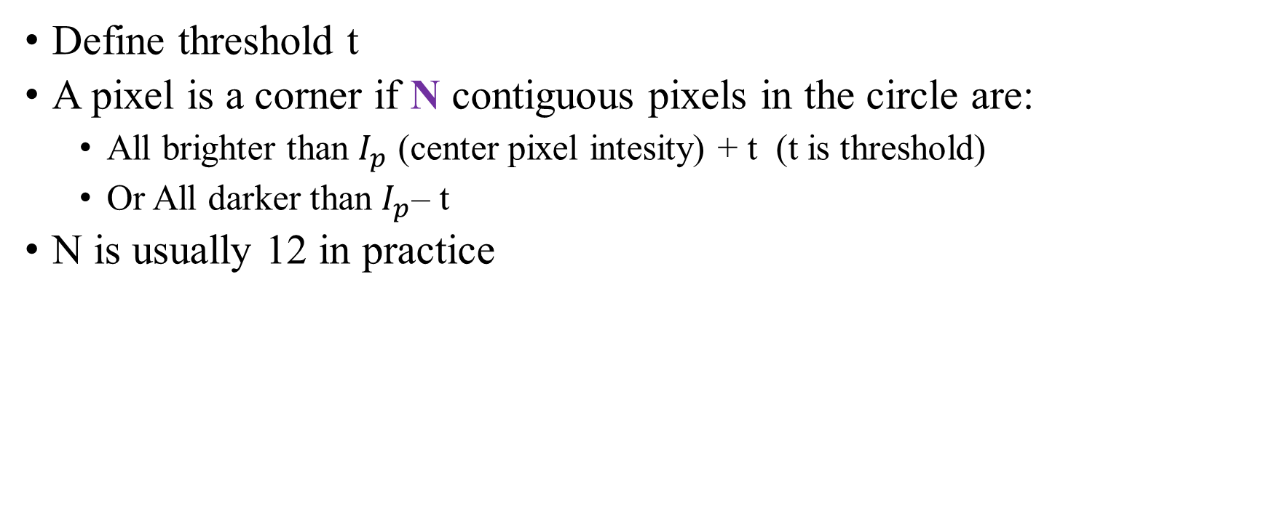
FAST Features Extractor (Segment test)
Define threshold t
A pixel is a corner if N contiguous pixels in the circle are:
All brighter than $I_{p}$ (center pixel intesity) + t (t is threshold)
Or All darker than $I_{p}$– t
N is usually 12 in practice

Slide 42
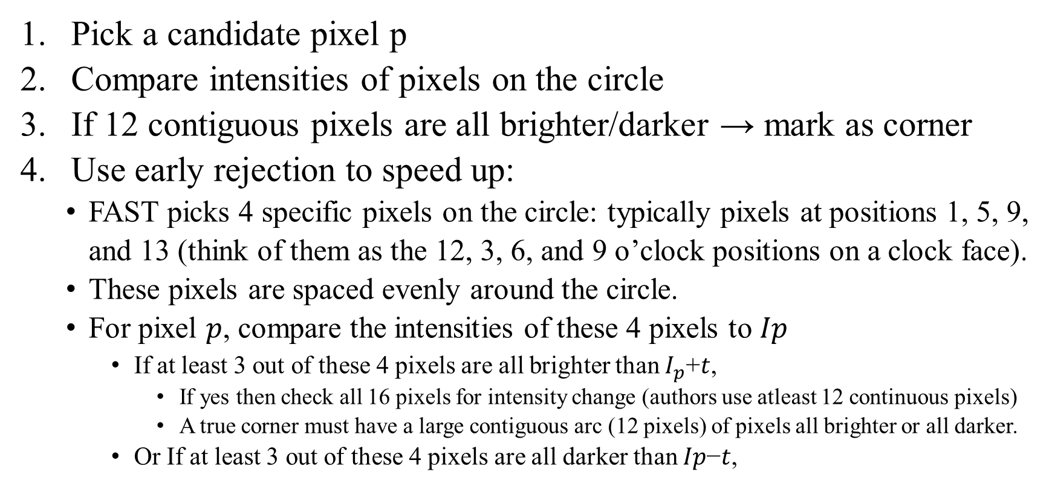
FAST Features Extractor (Algorithm)
Pick a candidate pixel p
Compare intensities of pixels on the circle
If 12 contiguous pixels are all brighter/darker → mark as corner
Use early rejection to speed up:
FAST picks 4 specific pixels on the circle: typically pixels at positions 1, 5, 9, and 13 (think of them as the 12, 3, 6, and 9 o’clock positions on a clock face).
These pixels are spaced evenly around the circle.
For pixel 𝑝, compare the intensities of these 4 pixels to 𝐼𝑝
​If at least 3 out of these 4 pixels are all brighter than $I_{p}$+𝑡,
If yes then check all 16 pixels for intensity change (authors use atleast 12 continuous pixels)
A true corner must have a large contiguous arc (12 pixels) of pixels all brighter or all darker.
Or If at least 3 out of these 4 pixels are all darker than 𝐼𝑝−𝑡,

Slide 43
FAST Features Extractor (Performance)
Early termination greatly speeds up processing
No need to compute gradients
No floating-point math
FAST is one of the fastest corner detectors

Slide 44
FAST Features Extractor (Non maximal suppression)
FAST detects many candidate corners — sometimes several in a small neighborhood.
This leads to multiple detections clustered tightly around the same feature.
Without filtering, the output is noisy and redundant, making later matching inefficient.
NMS is a post-processing step to keep only the strongest corner response in a local neighborhood.
It suppresses (removes) corners that are not the local maximum in terms of corner strength.
The result is a cleaner, sparser, and more distinctive set of corners.

Slide 45
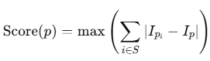
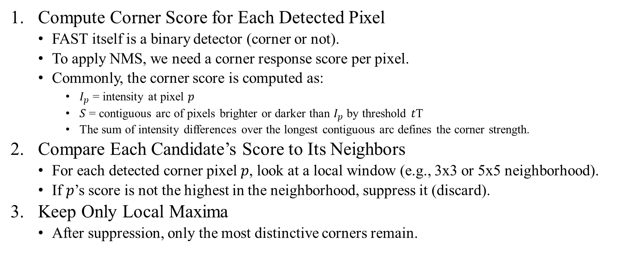
FAST Features Extractor (Non maximal suppression)
Compute Corner Score for Each Detected Pixel
FAST itself is a binary detector (corner or not).
To apply NMS, we need a corner response score per pixel.
Commonly, the corner score is computed as:
$I_{p}$​ = intensity at pixel 𝑝
𝑆 = contiguous arc of pixels brighter or darker than $I_{p}$​ by threshold 𝑡T
The sum of intensity differences over the longest contiguous arc defines the corner strength.
Compare Each Candidate’s Score to Its Neighbors
For each detected corner pixel 𝑝, look at a local window (e.g., 3x3 or 5x5 neighborhood).
If 𝑝’s score is not the highest in the neighborhood, suppress it (discard).
Keep Only Local Maxima
After suppression, only the most distinctive corners remain.

Slide 46
FAST Features Extractor
Pros | Cons
Extremely fast | Not scale-invariant
Simple and efficient | No descriptor
Good for real-time systems | Not rotation-invariant

Slide 47
SURF (Speeded Up Robust Features)
Introduced: 2006 by Bay et al. based on his PhD. Thesis (ETH Zurich, 2009)
Purpose: Detect and describe local features in images
The main interest of the SURF approach lies in its fast computation of operators using box filters, thus enabling real-time applications such as tracking and object recognition.
Inspired by: SIFT (Scale-Invariant Feature Transform)
Key Attributes:
Faster than SIFT
Utilizes integral images and box filters
Scale Invariance: Multi-scale detection
Rotation Invariance: Orientation assignment
Robustness: Performs well under noise, blur, and lighting changes

Slide 48
SURF (Speeded Up Robust Features)
Algorithm steps:
Integral Image Calculation
Interest Point Detection using Hessian Matrix
Scale-space Pyramid Construction
Keypoint Localization
Orientation Assignment
Descriptor Extraction

Slide 49


SURF Algorithm
Step 01(Integral image)
Definition: Intermediate representation for fast computation
Purpose: Enables fast computation of box filters
Benefit: Reduces computational cost drastically
Formula:
In other words, 𝐼∑(𝑥,𝑦) stores the sum of all pixels above and to the left of the pixel (𝑥,𝑦), inclusive.

Slide 50


SURF Algorithm
Step 02 (Interest point detection)
Technique: Use of Hessian Matrix
Why Hessian? Sensitive to blob-like structures
Hessian Matrix Definition:
The determinant of the Hessian matrix det⁡(𝐻) measures the local change in intensity curvature.
A large determinant value indicates a strong blob-like structure (intensity changes in multiple directions).
Box Filters approximate second-order Gaussian derivatives for speed

Slide 51

SURF Algorithm
Step 02 (Interest point detection)
Box Filters approximate second-order Gaussian derivatives for speed.
Computing exact second-order derivatives of Gaussian $L_{xx}$, $L_{yy}$ ​, $L_{yy}$​, $L_{xy}$​ is computationally expensive.
Instead, box filters (rectangular filters) are used as a fast approximation of these derivatives.
Box filters can be computed very quickly using the integral image data structure.
This approximation dramatically speeds up the detection process, enabling real-time applications (used in algorithms like SURF).

Slide 52

SURF Algorithm
Step 03 (Scale Space representation)
Approach: Instead of image downsampling, increase filter size (On contrary to SIFT here filter size is increase as it is computationally cheap)
Octaves & Intervals: Filters of increasing size detect features at different scales
Efficient Computation: Thanks to integral image and box filters
Box Filters approximate second-order Gaussian derivatives for speed

Slide 53
SURF Algorithm
Step 04 (Keypoint localization)
Non-maximum Suppression: Across space and scale
Interpolation: Sub-pixel accuracy using Taylor expansion
Criteria: Discard unstable points (low contrast, edge responses)

Slide 54
SURF Algorithm
Step 04 (Orientation assignment)
Goal: Achieve rotation invariance
Method: Haar wavelet responses in a circular neighborhood
Weighted with Gaussian
Dominant orientation chosen via histogram peak
Output: Each keypoint gets a single orientation
Haar Wavelet Responses in a Circular Neighborhood
Around each keypoint, consider a circular region of a fixed radius (depending on scale).This region is where we calculate the keypoint's dominant orientation.
Haar wavelet responses:
Compute Haar wavelet responses (simple filters that measure intensity changes) in both x and y directions at multiple sample points within the circular region.
Responses closer to the keypoint center are given more importance.
This is done by weighting each response by a Gaussian centered on the keypoint, emphasizing local information and reducing the influence of distant pixels.

Slide 55
SURF Algorithm
Step 04 (Descriptor Extraction)
Region: 20x20 region around keypoint
Subdivision: Into 4x4 sub-regions (16 total)
Features per Sub-region:
Sum of Haar wavelet responses: dx, dy, |dx|, |dy|
Final Descriptor:
64-dimensional vector (16 subregions × 4 values)

Slide 56
SURF Algorithm
Feature | SURF | SIFT
Speed | Faster | Slower
Descriptor Size | 64 | 128
Robustness | High | Very High
Patent | Yes (was) | Yes (was)
Implementation | OpenCV, MATLAB | OpenCV, MATLAB

Slide 57
Binary Robust Independent Elementary Features (BRIEF)
Types of descriptors:
Floating-point (SIFT, SURF) e.g., SIFT descriptor = [0.2, 0.1, 0.199, ….]
Binary (BRIEF) e.g., BRIEF descriptor = [1, 0, 0, 1, 1, 1, 0 ….]
BRIEF focuses on binary descriptors for speed and efficiency
Uses simple intensity comparisons instead of gradients
Very fast to compute and match
Describe a keypoint by comparing pixel intensities at pairs of points
Each pair gives a single binary value (0 or 1)
Combine many such comparisons into a binary string (descriptor)

Slide 58

BRIEF Algorithm
Step 1: Detect keypoint (using any detector, e.g., FAST, SIFT, SURF, ORB)
Step 2: Select a smoothed patch around keypoint (e.g., 31x31 pixels)
The patch is often smoothed (using Gaussian blur) to reduce noise and minor local variations.
Step 3: Predefined random pairs of pixel locations within patch
The location of pixels pair that will be compared need to be fixed
Step 4: Compare intensities of each pair, output 1 if first > second, else 0
This is repeated for all 128 or 256 pairs to form the binary descriptor.

Slide 59

BRIEF Algorithm
Example: Intensity Comparison
Show a 31x31 patch with sample point pairs
Illustrate comparison: if $I_{p} > I_{q}$then bit = 1, else 0
Repeat for all pairs → binary vector (e.g., 128 bits)
Typical BRIEF descriptor length: 128 or 256 bits
Binary strings enable:
Compact storage
Fast matching using Hamming distance
Efficient for resource-constrained environments
Use Hamming distance (XOR + popcount) to compare two descriptors

Slide 60
BRIEF Algorithm
Limitations of BRIEF:
Not inherently scale or rotation invariant
Sensitive to image noise and viewpoint changes
Needs complementary keypoint detector with scale/orientation info
Enhancements Over BRIEF
ORB (Oriented FAST and Rotated BRIEF):
Adds rotation invariance and uses FAST keypoints
BRISK: Adds scale and rotation invariance with binary descriptors
These methods address BRIEF’s limitations

Slide 61
ORB (Oriented FAST and Rotated BRIEF)
ORB = Oriented FAST + Rotated BRIEF
Developed by Ethan Rublee et al. (2011)
A fast, efficient, rotation-invariant alternative to SIFT/SURF
Fully free and patent-free → Ideal for real-time & commercial use
Motivation for ORB:
SIFT & SURF were powerful but computationally expensive
Patent restricted
ORB offer:
Speed (real-time capable)
Binary descriptors (compact)
Rotation invariance
Robust matching

Slide 62
ORB Algorithm
Keypoint detection using FAST
ORB starts by detecting keypoints using the FAST (Features from Accelerated Segment Test) corner detector.
FAST is a very fast corner detector, but it lacks:
Scale information
Orientation
Built-in filtering
Keypoint orientation estimation using intensity centroid
ORB uses the intensity centroid method:
It computes the center of mass (centroid) of the image intensities within a patch around the keypoint.
The vector from the keypoint to the centroid gives the orientation.
The angle θ of this vector is used to rotate the descriptor later.
Descriptor construction using Rotated BRIEF
Feature matching via Hamming distance

Slide 63
ORB Algorithm
Keypoint detection using FAST
ORB starts by detecting keypoints using the FAST (Features from Accelerated Segment Test) corner detector.
Keypoint orientation estimation using intensity centroid
ORB uses the intensity centroid method:
Descriptor construction using Rotated BRIEF
BRIEF (as discussed earlier) is not rotation-invariant by default.
ORB fixes this by rotating the sampling pattern of BRIEF according to the keypoint’s orientation θ.
The 128 or 256 predefined pixel pairs (used for intensity comparisons) are rotated around the keypoint before comparisons.
Feature matching via Hamming distance
Hamming distance = number of differing bits.
Very fast using bitwise XOR + popcount.

Slide 64
Image Feature Extractor Benchmarking 2025
Feature Extractor | Matching Accuracy | Speed | Real-time? | Use Case
ORB | Low-Medium | Very Fast | ✅ | Real-time SLAM, mobile
SIFT | High | Slow | ❌ | Baseline accuracy testing
SuperPoint | High | Fast (GPU) | ✅ | SLAM, AR
D2-Net | Very High | Slow | ❌ | 3D Reconstruction
LoFTR | State-of-the-art | Medium/Slow | ❌ | Wide-baseline matching, relocalization
DISK | High | Medium | ❌ | Matching, detection

Slide 65
Summary
Feature extraction is an important task of computer vision.
The feature extractor should extract keypoints with invariance to various factor of images.
The descriptor is also required to be compact and robust for matching.
SIFT is one of the most widely used feature extractor and descriptor.
FAST is very fast feature extractor .
BRIEF is binary descriptor that make matching very fast.

